Slide 1
Burns
Diagnosis, Treatment and Prevention

Slide 2
Burns - Epidemiology
National burden
Worldwide burden
Importance of Burn Centers
Prevention is critical

Slide 3
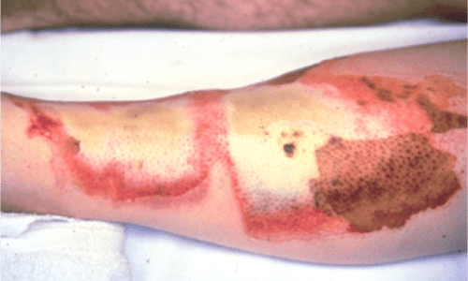
Burns
Diagnosis, Treatment and Prevention
This Photo by Unknown Author is licensed under CC BY-SA-NC

Slide 4
Burns – The spectrum of Injury
Flame burns
Liquid burns – scalds, immersion injuries
Inhalation Burns – closed space

Slide 5
Burns
1st degree – epidermis
2nd degree – dermis
3rd degree - deep to dermis
Degree of Injury

Slide 6
Burns – defining the Injury
Rule of Nines – Clinical aid to help determine the extent of the burn injury - 18% trunk front 18% trunk back, 9% each arm, 18% for each leg, 9% head, 1% for scrotum

Slide 7
Burns – Diagnosis, Treatment and Prevention
Burns requiring admission
Burns to hands, feet, face, perineum, scrotum
Electrical burns
Chemical Burns
Burns greater than 10%BSA
Burns in the setting of blunt truncal trauma (associated injuries)
Pediatric Burns
Inhalation Injuries

Slide 8
Burns
Fluid Resuscitation in Burns
2cc/kg/%BSA – Give ½ requirement in 8 hrs
Monitor resuscitation
Diagnosis, Treatment and Prevention

Slide 9
Burns
Give half of the estimated deficit in the first 8 hours. Monitor urine output and usual cardiovascular parameters of resuscitation.
For electrical burns use 4cc/kg/%BSA burn

Slide 10
Burns
Severe 3rd degree burns with full thickness involvement of the trunk may require escharotomies to eliminate respiratory constriction related to the burn wound itself

Slide 11
BurnS - Treatment
Assess and secure the airway first
Stop the burning process
Protect the skin
Airway, Breathing and Circulation

Slide 12
BurnS - Complications
Compartment Syndrome
Pain out of proportion to the physical findings
Pain on passive stretch
Compromised perfusion
Fasciotomy can be limb saving
Always remember to check for myoglobinuria and hydrate

Slide 13
Burns
Early Skin grafting may decrease the inflammatory response
Early enteral nutrition – to promote wound healing
Early beta-blockade – once resuscitation has been complete

Slide 14
Smoke Inhalation
Classical history is a burn sustained in a closed space
Singing of nasal hairs
Carbonaceous sputum
Early intubation is recommended before airway edema worsens

Slide 15
Smoke INhalation
Must consider carbon monoxide as part of the clinical picture. Carboxyhemoglobin must be obtained and 100% oxygen can be used to facilitate resolution. If severe clinical findings including coma, consider hyperbaric therapy.

Slide 16
Smoke Inhalation Continued
Monitor for nosocomial pneumonia
Treat with antibiotics if pneumonia suspected

Slide 17
Burns - Prevention
Many Scald injuries involving small children can be prevented.
Do not leave children unattended in the kitchen
Do not allow children to go near counters or open flames
Do not allow children to climb up onto counters to get anything
Do not leave children alone in the bathtub with the water running
Always check the temperature of bath water before allowing a child to enter the tub.

Slide 18
Burns - Prevention
Do not smoke in bed
Have home functioning smoke detectors
Do not leave open flames on the stove.
Turn off all ranges when not in use
Do not allow children to get into or use microwave devices
Do not allow children to place their heads or any other part of the bodies into a stove.
Teach burn prevention in school and at home

